Slide 1
Michele Merkle
Air Traffic Services

Slide 2
Reminders
TBO website: https://www.faa.gov/air_traffic/technology/tbo/
Please mute your microphones
There are multiple ways to ask a question:
  Submit your questions via email 9-AJT-TBO@faa.gov
  Submit your questions via chat
  Raise your hand to alert the moderator

Slide 3
TBO Evolution
(We are Here)
Infrastructure
Initial
Full and Dynamic
En Route & Terminal Automation
TBFM
TFMS
SWIM
AIMM
Data Communications
ADS-B
PBN/Metroplex
CSS-Wx/NWP
TFDM
Arrival Metering
Extended Metering
RNAV STARS and SIDs
RNP/RNP with RF
Established on RNP
Time based Dep Management
Dep Clearances and Initial En Route Services via Data Comm
Airborne Reroutes
Pre-Departure Reroutes
CTOP
Terminal Metering
Automated Surface Mngt
Improved Dep Planning
Path Stretch
Enhanced Time-Based Arrival Metering
Improved Metering in Off-Nominal Conditions
Improved Departure Operations Using Mobile Applications
Improved Strategic Flow Management
Multiple Airport Route Separation
Improved Strategic Flight Planning
Airborne Flight Negotiation
ADS-B In enabled spacing applications
Dynamic Wake Separation
Dynamic RNP
4D Trajectory Management
Common Framework for Collaboration, Operations,
and Performance Based Navigation
Capabilities for integrated arrival and departure operations
Integrated Automation Capabilities for
Advanced Trajectory Management,
and Individual Aircraft Solutions
Operationally Available in at least one location
In Acquisition
Planned or In Research
Note: Implementation timeframes are in flux due to COVID impacts. Deployment decisions on future capabilities will depend on research results, shortfalls that remain after initial implementation and other constraints such as budget, workforce training and sustainment needs.

Slide 4
Dan Murphy
Systems Operations Services

Slide 5
Jeff Woods
National Air Traffic
Controllers Association

Slide 6
TBO Status Update and Plans
Wendy O’Connor, Air Traffic Services
Phil Hargarten, National Air Traffic Controllers Association

Slide 7
TBO Overview
TBO is a collection of systems, capabilities, processes,
and people working together to achieve operational objectives
Time-Based Management
(TBM)
Performance Based Navigation
(PBN)
Enabling Technologies
Dep Scheduling, Airborne Metering and Automated Surface Mngmt.
Complemented by
Conventional TMIs as Needed
SWIM
DataComm
Web-based Planning Tool
Etc.
Metroplex
RNP w/RF Turns
Etc.
Helps Manage Trajectories by Scheduling and Metering Aircraft Through Constraint Points
Enables Aircraft to More Accurately Navigate Along
Their Trajectories
Expands and Automates Sharing of Common Information About Aircraft Trajectories

Slide 8
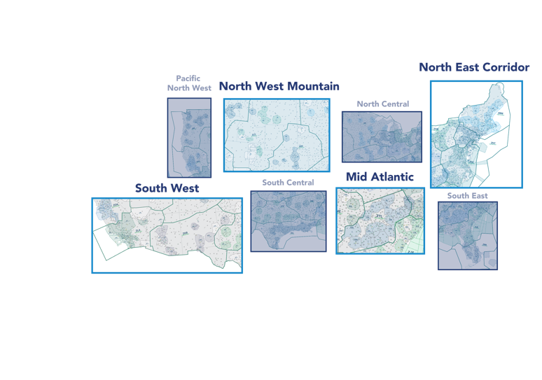
TBO Implementation Approach
Geographically-based
Areas reflect logical and inter-dependent TBM and PBN operational relationships
Operational geographic scope is flexible and not necessarily aligned with existing airspace or organizational boundaries
Operating
Areas
Holistic
Cross-facility focused for NAS wide benefits
Integrated, incremental and systematic deployment
Opportunity-driven
Based on operational readiness, benefit opportunities, and anticipated costs and risks
Supportive
Sustained communication, training, and technical support
Planning and execution will be collaborative

Slide 9

Key TBO Implementation Milestones
Operating Areas
North East Corridor
IDAC – MDT, ISP 2021
Improved TBM to PHL, EWR – 2022-23
  Infrastructure
  Dep Scheduling
  Airborne metering (times on glass)
Improved Dep Management for flights destined to LGA – TBD
Atlantic Coast Routes – TBD
PDRR/ABRR Enhancements (TFMS R14) – 2021
North West Mountain
DEN Metroplex
Integrated Departure Arrival Capability (IDAC) – 2021-22
Extended Metering to DEN
  Infrastructure
  Dep Scheduling
  Airborne metering (times on glass)
DEN Terminal Sequencing and Spacing (TSAS) – 2022
South West
LAS Metroplex – 2021
Update airspace/procedures infrastructure – 2021
IDAC
Extended Metering – LAX 2022
  Infrastructure
  Dep Scheduling
  Airborne metering (times on glass)
LAX TSAS – 2023
TFDM – PHX Build 1 IOC 2022
NAS-Wide
En Route Departure Capability (EDC)
Pre-departure reroute & Airborne reroute (except ZNY)
Tower CPDLC Services – Core 35 completed
Additional Tower CPDLC Services?
En Route CPDLC Services – Initial, Full (TBD)
TFDM (89 locations) – TBD
Reroute Impact Assessment (TFMS R15) – 2022
Surface Viewer (TFMS R15 & TFDM) – 2022
Mid Atlantic
Adjacent Center Metering – ATL
Departure Scheduling
Arrival Metering (ATL/CLT)
IDAC
Airspace/procedures infrastructure update
Evaluate Extended Metering for ATL
TFDM – CLT Build 2 IOC 2023
All implementation dates subject to change due to COVID impacts, budget, sustainment needs, workforce training, and other constraints

Slide 10
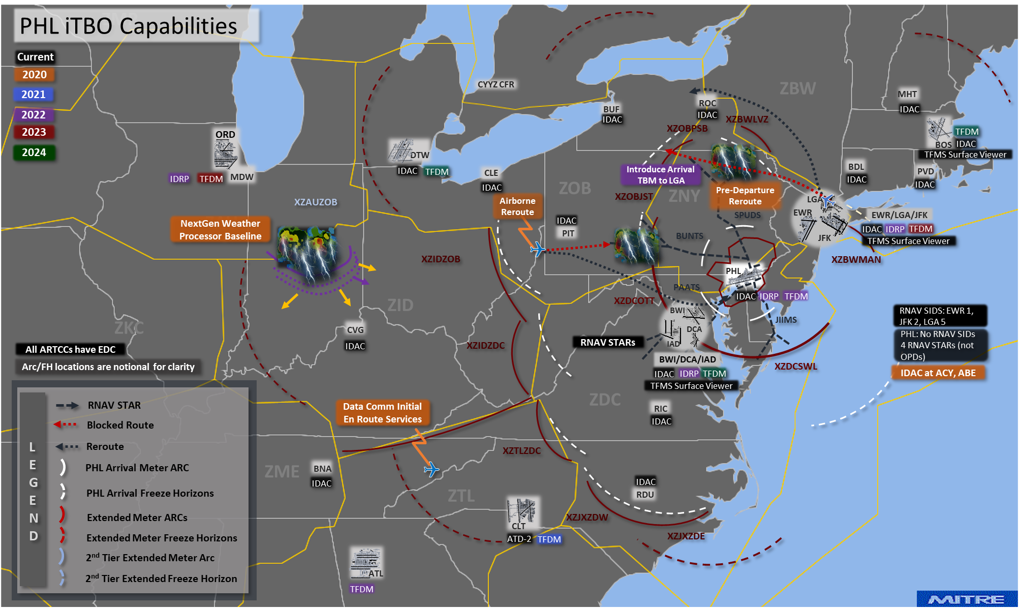
Northeast Corridor (NEC) Status
Northeast Corridor
Key Issues
EWR airspace transition from N90 to PHL for TBO: Fall 2021
ZNY and PHL TRACON staffing
Technical Training Lab (TTL) availability for PHL/EWR airborne metering
DSP subsumption plan impacts
Recent Progress
National TBFM Ops Team working on initial EWR XM design.
IDAC: Islip (ISP) & Harrisburg (MDT)
  Training and hardware installation planned for summer 2021.
Implemented departure scheduling from ZNY & ZBW to ATL & CLT April 2021
  Included ZDC. Part of time-based management using TBFM.
NAC PBN and Opportunities Ad Hoc Tasking recommendations:
  Implemented LGA Runway 31 Park Visual procedure April 2021.
  Tested Teterboro Teterboro/White Plains (HPN) Escape route March 2021. Next step: examine performance as part of the operation.
  These initiatives improve flows in and out of NEC.
Worked on design to implement departure scheduling and full metering to PHL and EWR, incorporating move of EWR airspace to PHL TRACON.
  Includes work at 8 facilities.
Atlantic Coast Routes implementation: completed 85% of commitments.
North East Corridor
IDAC
Improved TBM to PHL, EWR – 2022-23
  Infrastructure
  Departure Scheduling
  Airborne metering (times on glass except ZAU)
Improved Departure Management for flights destined to LGA – TBD
Atlantic Coast Routes – 2022
PDRR/ABRR Enhancements – 2021

Slide 11
Northeast Corridor (NEC) Metering Transition Roadmap
EWR Transition to PHL TRACON Completed
Phase 2
ZID/ZJX/ZOB/ZTL Training/Metering PHL/EWR
Phase 4
ZNY Training/Metering to PHL EWR
  ATC training on TBFM at ZBW airborne metering
  TMC Departure Scheduling Training ZAU, ZBW, ZID, ZJX, ZOB, ZTL
  XM timeline management and XM behavior/permissions training for all facilities ZBW, ZID, ZJX, ZOB, ZTL
  TMC training timeline management and behavior/permissions for PHL TRACON
  Begin Airborne Metering (times on glass) for PHL/EWR at ZID, ZJX, ZOB, ZTL
  TMCs begin Departure Scheduling for PHL/EWR at ZBW, ZID, ZJX, ZOB, ZTL
  ZDC and ZNY will continue to run MIT to PHL/EWR TRACON
  Train ZDC Controller workforce on TFDM
  Begin ZDC airborne metering (“times on glass”) for PHL/EWR at ZID, ZJX , ZOB, ZTL
  Begin Departure Scheduling for PHL/EWR at ZDC
  ZNY will continue to run MIT to PHL TRACON
  Train ZNY TMC’s on timeline management and behavior/permissions
  Train ZNY controller workforce on TBFM
  Begin ZNY airborne metering (“times on glass”) for PHL/EWR at ZNY
  Begin Departure Scheduling for PHL/EWR at ZNY
Q1 CY 2022
Q4 CY 2022
Q1 CY 2023
Q4 CY 2023
Phase 1
ZBW Training/Metering to PHL/EWR
Phase 3
ZDC Training/Metering to PLH/EWR

Slide 12
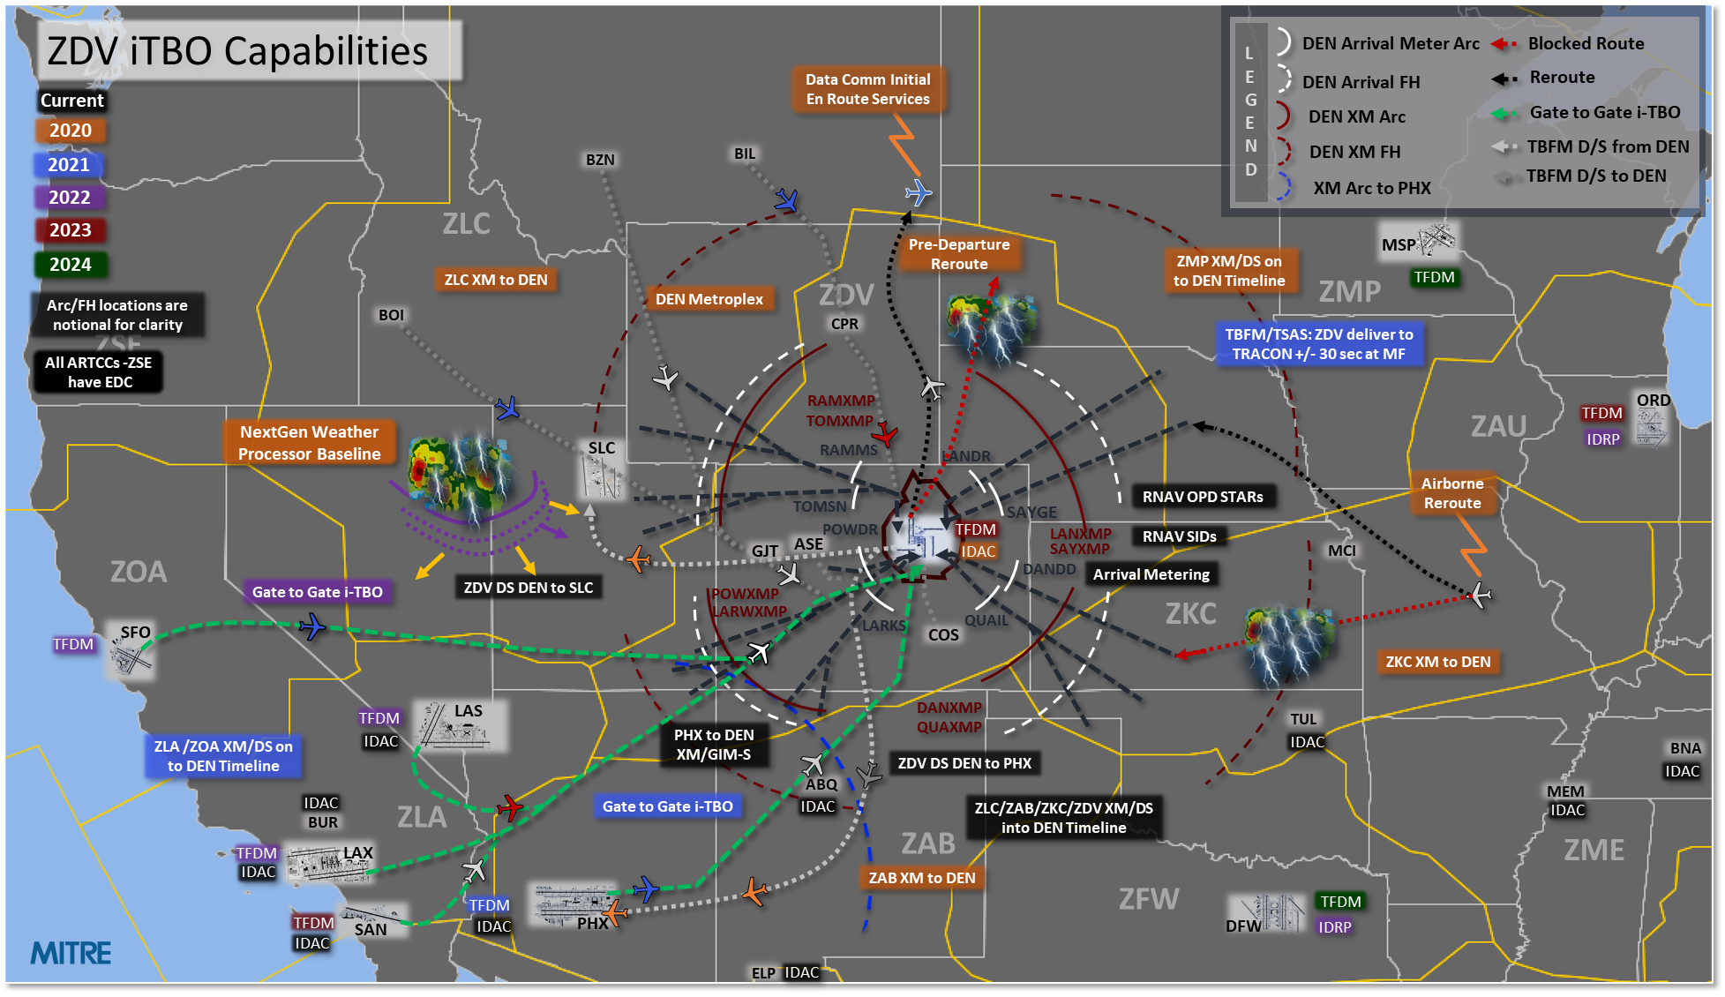
Northwest Mountain Status
Northwest Mountain
Key Issues:
TRACON staffing (TMCs, Supervisors) to support full-time TSAS operation
ZDV will no longer provide “expect runway” info for DEN arrivals by October 2021
Recent Progress:
Implemented extended metering to DEN from adjacent facilities again June 30, 2020 as traffic increased. Continued to refine ZDV metering system with onsite work at ZDV.
TSAS testing resumed at Tech Center in ACY April 2021 (D01 will be 1st TSAS site with 2022 implementation). First on-site TBFM adaptation support since start of COVID-19 (week of May 3).
Initial revised D01 TRACON adaptation delivered to SLE. Final testing completed and interactions with ZDV and D01 SMEs begun in April.
Completed assessment to verify 30-sec (95%) Delivery Accuracy Goal is appropriate for DEN TSAS operations; determining next steps and planning test Q4 CY2021.
North West Mountain
DEN Metroplex
IDAC – TBD
Extended Metering to DEN
  Infrastructure
  Dep Scheduling
  Airborne metering (times on glass)
DEN TSAS – 2022

Slide 13
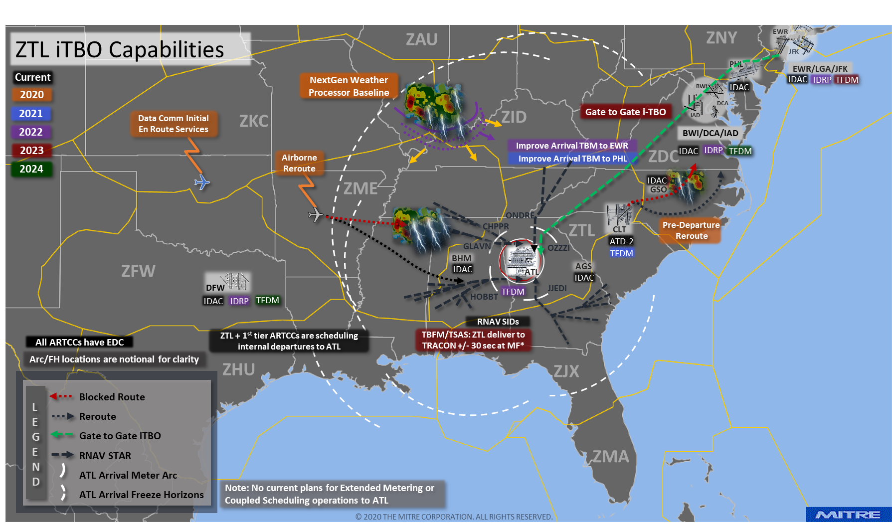
Mid-Atlantic Status
Mid-Atlantic
Key Issues:
Assess need for XM/CS design for ATL
Recent Progress:
To improve delay distribution for Mid Atlantic airspace, implemented enhanced interfaces between automation systems at ZNY, ZBW, ZTL and ZJX for TBFM departure scheduling to ATL and CLT.
  Operational on departure scheduling April 5, 2021
  Testing on support string, then will install on ops
Established T-to-T for ZTL and ZJX to MCO.
Mid Atlantic
Adjacent Center Metering (ATL/CLT)
  Departure Scheduling
  Airborne Metering (times on glass)
Evaluate extended metering for ATL
IDAC
Airspace/procedures infrastructure update
TFDM – CLT Build 2 IOC 2023

Slide 14
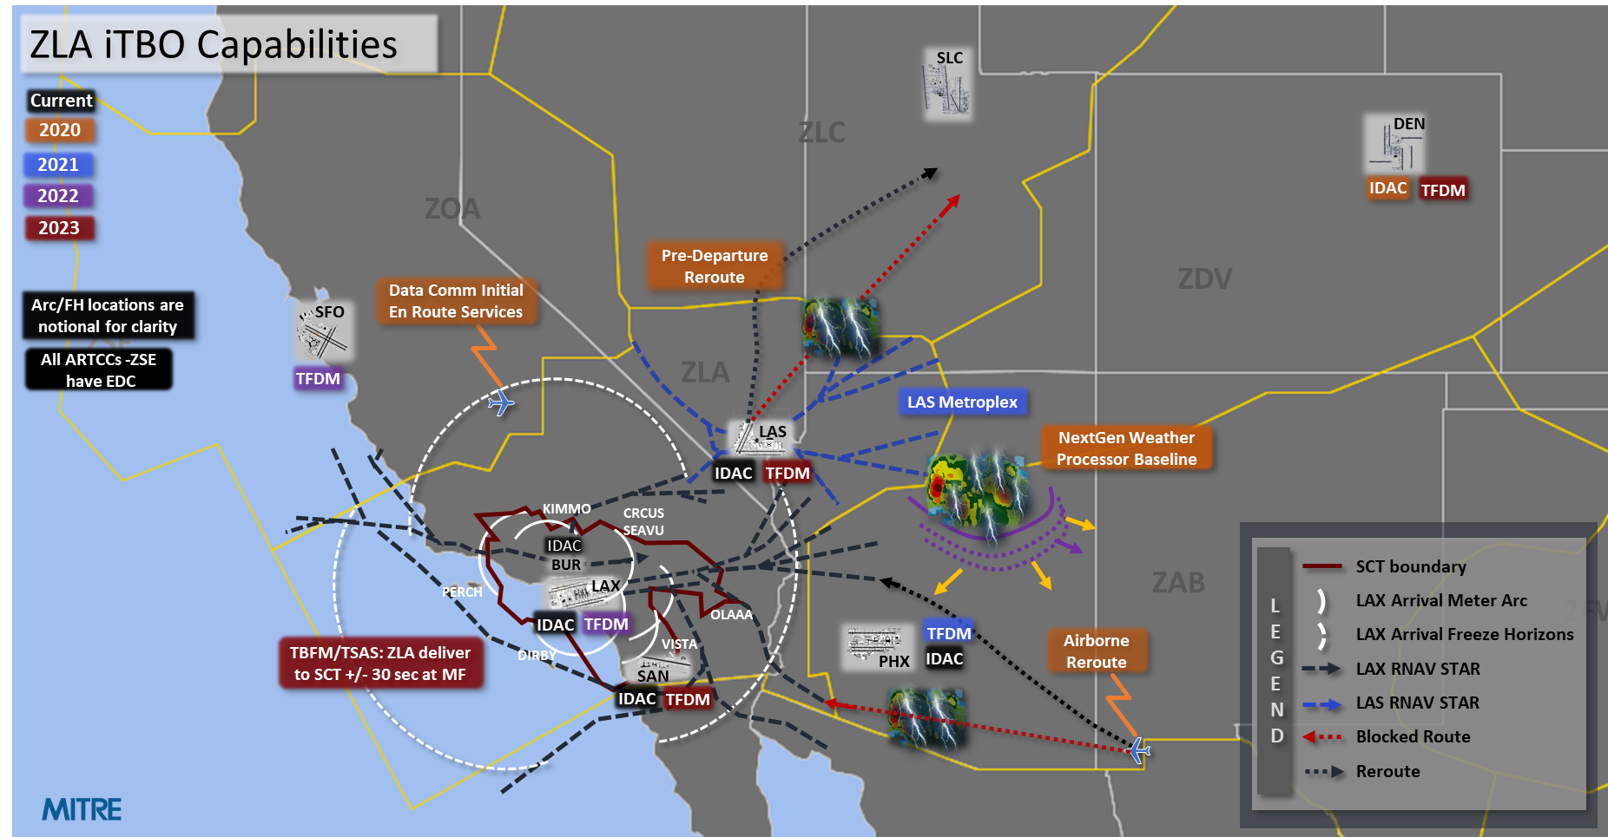
South West Status
Southwest
Key Issues
Develop preliminary TSAS adaptation
Recent Progress
LAS Metroplex implementation Feb 25, 2021
Developing Converging Runway Display Aid (CRDA) adaptation onsite at SCT to assist with Established on RNP (EOR) at LAX (supports TBO and Section 547). Team onsite at SCT 5/17 week; expect training completed Aug 2021.
LAX TSAS adaptation design (SCT will be 2nd TSAS site, 2023 implementation)
TBFM extended metering designs for LAS and LAX and adjacent facilities, including onsite work at ZLA (first onsite support in >1 year).
First prototype TSAS adaptation for LAX released to FAA SLE; delivered updated adaptation in prep for initial site shadowing.
  TSAS Ops team onsite at SCT 5/17 week for TSAS pre site survey for equipment.
iTBO interoperability assessment planned summer 2021, fully remote
South West
LAS Metroplex – 2021
Update airspace/procedures infrastructure – 2021
IDAC
Extended Metering for LAX – 2022
  Infrastructure
  Dep Scheduling
  Airborne metering (times on glass)
LAX TSAS – 2023
TFDM – PHX Build 1 IOC 2022

Slide 15
Recent Accomplishments
Implementation Milestones | NEC – Departure scheduling from ZBW & ZNY for ATL & CLT upgraded to allow scheduling onto arrival timeline; full implementation begun March 2021 TSAS testing resumed at Tech Center in ACY April 2021 Developing CRDA adaptation onsite at SCT to assist with EOR at LAX
Stakeholder Engagement | Ongoing NAC, NAC SC, and NEC NIWG meetings Coordinating TBO and other strategies with Deployment Coordination Committee (DCOM—European Union); preparing for June 3 working session
Communication | TBO Industry Day, NAC, NCF, CDM, SWIFT, etc.
Training/ Education | TBFM Fundamentals Course for Controllers (on INET; delivered in February) TBO Training Workgroup reviewing TMC training improvement opportunities
Workforce Alignment | Revision to ATC Orders (7210.3) submitted for Publication in June 2021 Updated Controller/Pilot Glossary under review (Dec 2021)
Performance Assessment | Consensus on success criteria metrics Initial development of analytical platform based on agreed-to data architecture

Slide 16
Questions?

Slide 17
TBO
Decision Making and Data Flow
Wayne Hubbard, Systems Operations Services
Matt Gammon, National Air Traffic Controllers Association
Doug Swol, Program Management Organization
Almira Ramadani, Air Traffic Services

Slide 18
Interactive
Infographics

Slide 19
Questions?

Slide 20
Wrap-up and Questions https://www.faa.gov/air_traffic/technology/tbo/
9-AJT-TBO@faa.gov

